Slide 1
The cost-effectiveness of multi-purpose HIV and pregnancy prevention technologies in South Africa
22nd International AIDS Conference
Amsterdam, 25 July 2018
Matthew Quaife, Fern Terris-Prestholt, Robyn Eakle, Maria A Cabrera Escobar, Maggie Kilbourne-Brook, Mercy Mvundura, Gesine Meyer-Rath, Sinead Delany-Moretlwe, Peter Vickerman

Slide 2
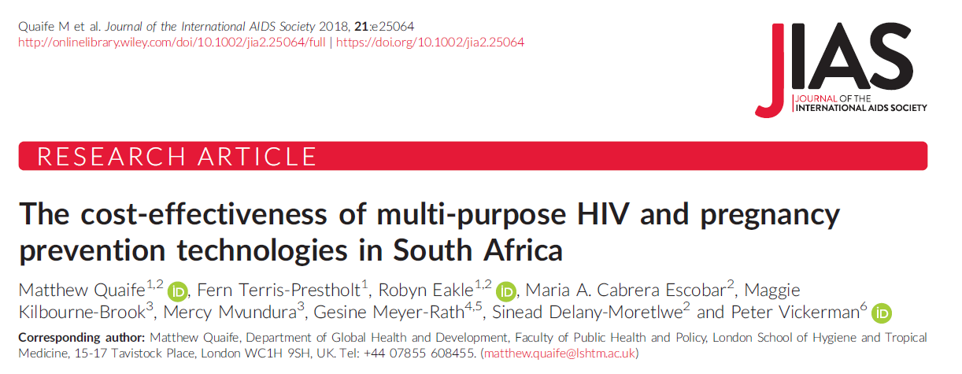
Conflicts of interest
None
JIAS publication for content presented here:

Slide 3
Background and motivation
South Africa has one of the largest and high profile generalised HIV epidemics in the world
Estimated 19% prevalence
Predominantly heterosexual epidemic, some nuances:
Women 1.4x more like to be HIV positive than men
Adolescent girls 8x more likely to be HIV positive than boys of the same age
HIV prevalence for female sex workers (FSWs) estimated >=50%

Slide 4
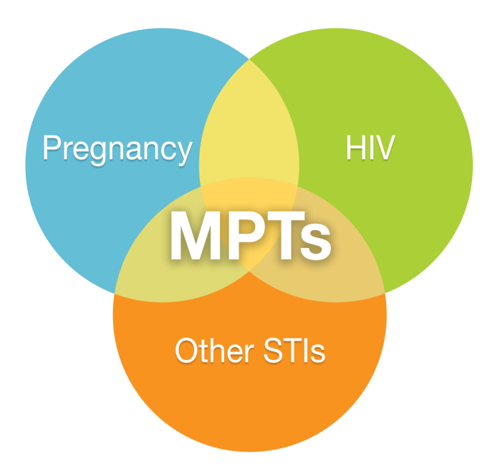
Multipurpose prevention technologies (MPTs)
Products which protect against TWO or more of HIV, pregnancy, or STIs
Product Candidate | Stage of Development | Indications
1) Dapivirine + Levonorgestrel Intra-Vaginal Ring (IVR) | Phase 1 | Pregnancy, HIV
2) MB66 Film | Phase 1 | HIV, HSV-2
3) MIV-150 and zinc acetate in carrageenan gel (PC-1005) | Phase 1 | HIV, HPV, HSV-2
4) Tenofovir + Levonorgestrel IVR | Phase 1 | Pregnancy, HIV, HSV-2
5) Tenofovir IVR | Phase 1 | HIV, HSV-2
6) Amphora Gel | Phase 3 | Pregnancy, Chlamydia, Gonorrhea
Source: IMPT
Source: IMPT, 2018

Slide 5
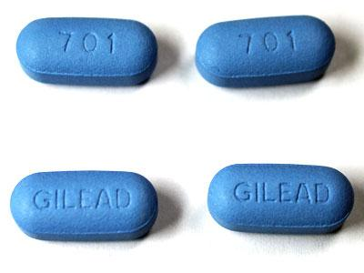
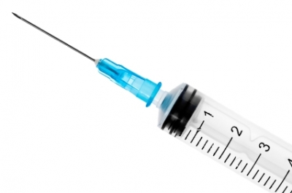
Multipurpose prevention technologies (MPTs)
Products which protect against TWO or more of HIV, pregnancy, or STIs
Source: IMPT

Slide 6
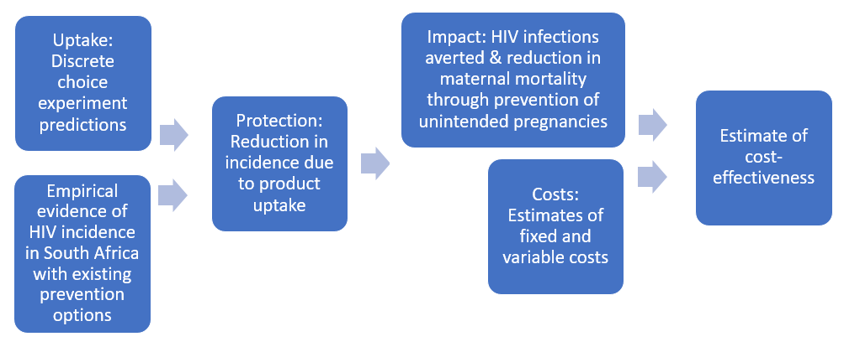
Methods

Slide 7
Predicting uptake
How can we predict uptake for products which don’t exist yet?
Model
Assumptions for model
Parameters
Structure
Impact and cost-effectiveness estimates

Slide 8
Predicting uptake
How can we predict uptake for products which don’t exist yet?
Assumptions from other studies
“Expert opinion”
Model
Assumptions for model
Parameters
Structure
Impact and cost-effectiveness estimates

Slide 9
Predicting uptake
How can we predict uptake for products which don’t exist yet?
Assumptions from other studies
“Expert opinion”
Model
Impact and cost-effectiveness estimates

Slide 10
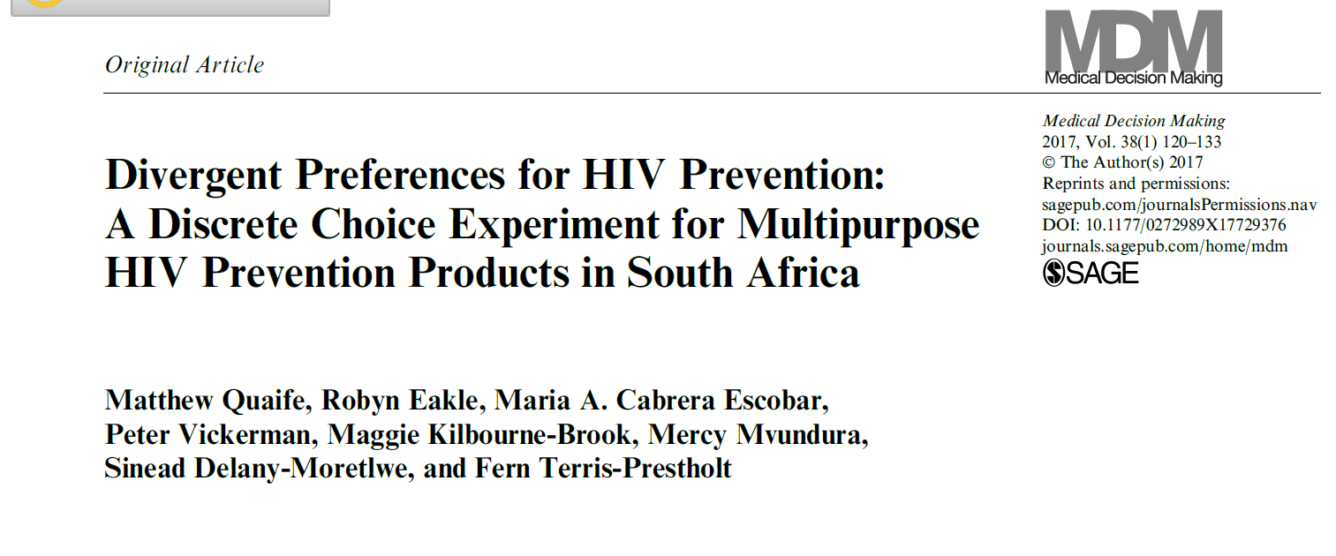
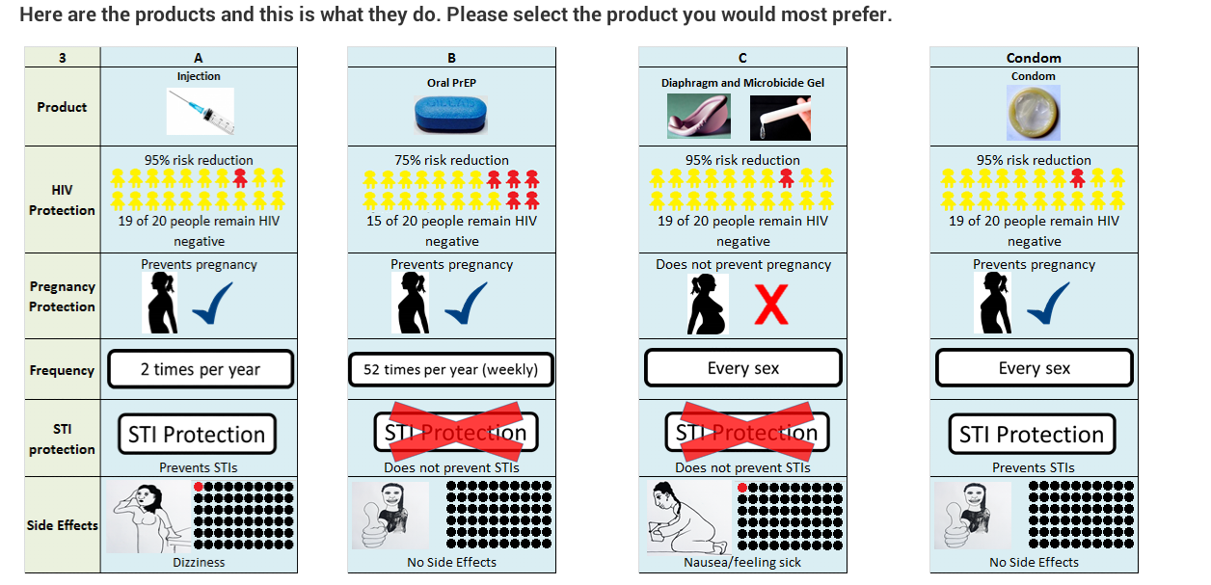
Predicting uptake
How can we predict uptake for products which don’t exist yet?
Assumptions from other studies
“Expert opinion”
We use a discrete choice experiment (DCE) to predict uptake of single- and multi-purpose products

Slide 11
Modelling impact
Simple static transmission model using South African demographic and HIV epidemiological data
For each product ($x$), protection is a function of efficacy ($E_{x}$) and use ($U_{x})$
$$P_{x}=E_{x}U_{x}$$

Slide 12
Modelling impact
Simple static transmission model using South African demographic and HIV epidemiological data
For each product ($x$), protection is a function of efficacy ($E_{x}$) and use ($U_{x})$
Then:
$$P_{x}=E_{x}U_{x}$$
Overall protection = additional protection from new products – condom migration + existing condom protection
$$P_{n}=U_{x}\left[\left(1−\left(1−ε\right)\sum_{i=1..n}{{Uc}_{i}}\right)E_{x}+\left(1−ε\right)\sum_{i=1..n}{{E_{i}Uc}_{i}}+ε\sum_{i=1..n}{{{\left(1−E_{x}\right)E}_{i}Uc}_{i}}\right]+\left(1−U_{x}\right)\sum_{i=1..n}{{E_{i}Unc}_{i}}\sum_{i=1..n}{{E_{i}Unc}_{i}}$$
$(1−ε$) = propensity to still use condoms, Uc and Unc = product use among condom/non-condom users, Ei = efficacy

Slide 13
Modelling impact
Estimate benefits from one year of product introduction
No consideration of staged uptake over time, adherence
Three female groups:
General population women aged 16-24, 25-49 & female sex workers(FSW)
DALYs averted through preventing HIV infections and reducing maternal mortality
Estimate model with low/medium/high HIV incidence for each group
No age-weighting
Discount rate 3% (all costs and benefits)
One-way and probabilistic sensitivity analyses used to explore parameter/structural uncertainty
Willingness-to-pay: lowest threshold of $1,175 (Woods et al. 2016)
More conservative than 1xGDP/capita (~$5,000)

Slide 14
Cost model
Fixed costs | National start-up costs | Training of providers Mass media
Variable costs | Facility distribution costs | Staff time Product Health system mark-up and overheads
 | Averted health costs | ART treatment Planned and unplanned miscarriage and births

Slide 15
Rollout scenarios
Scenario 1
Scenario 2
Scenario 3
Current practice
Next few years (1)
Next few years (2)
HIV
HIV &
pregnancy
HIV
HIV
HIV

Slide 16
Rollout scenarios
Scenario 1
Scenario 2
Scenario 3
Current practice
Next few years (1)
Next few years (2)
HIV
HIV &
pregnancy
HIV
HIV
HIV
Scenario 4
Scenario 5
Single-purpose kitchen sink
Multi-purpose kitchen sink
HIV
& pregnancy
HIV
HIV
& pregnancy

Slide 17
Cost-effectiveness
WTP Threshold: $1,175/DALY

Slide 18
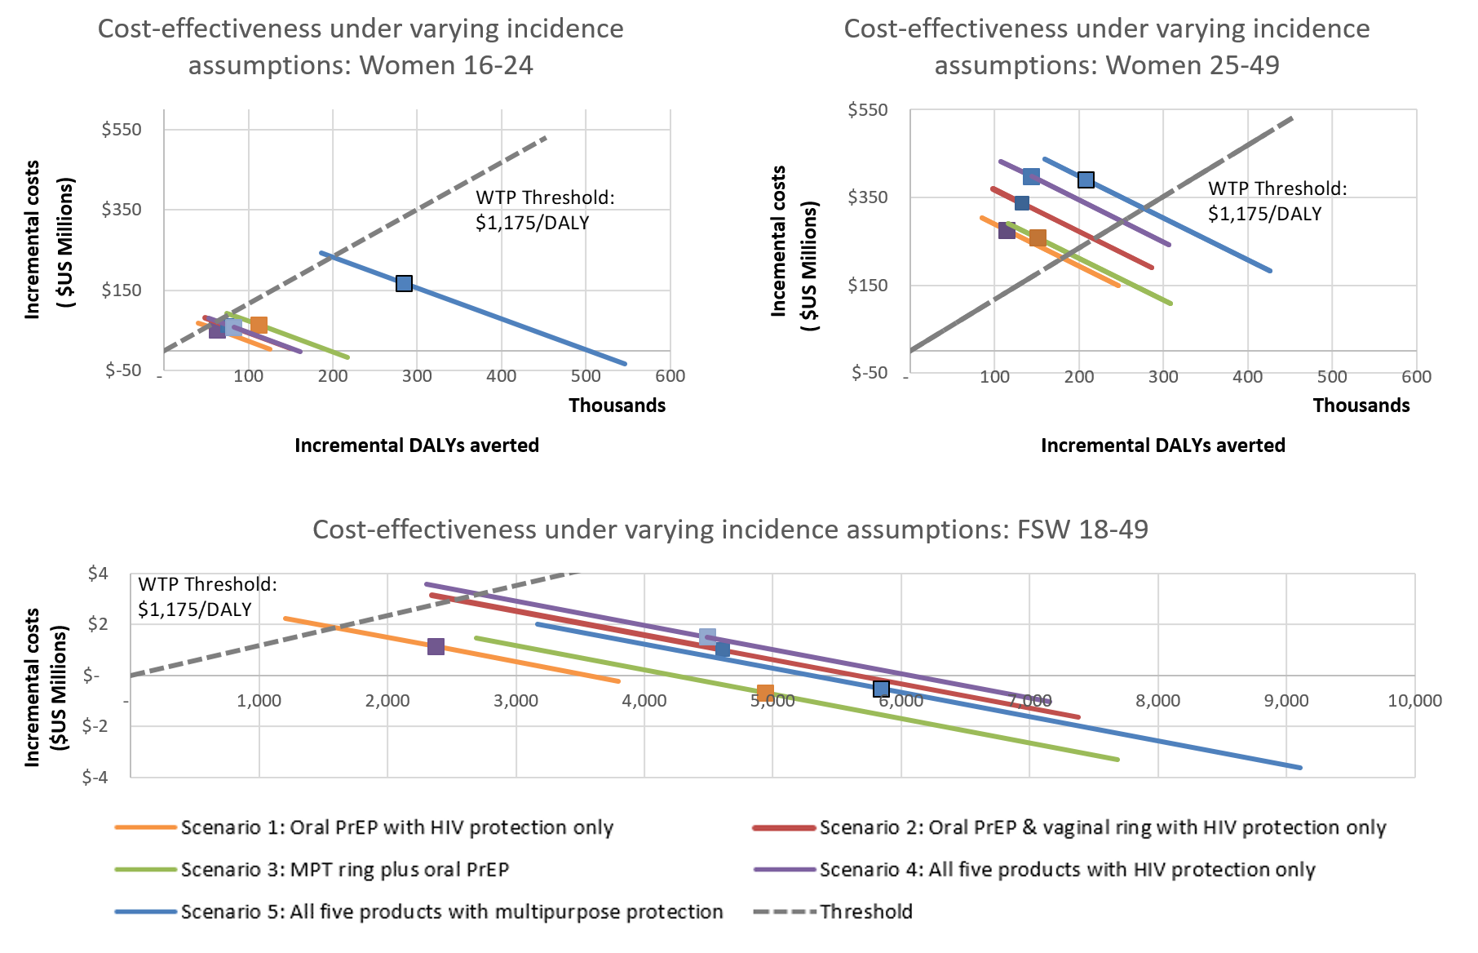
One-way sensitivity analysis: incidence

Slide 19
But PrEP is already here…
*Negative ICER values in this table indicate cost-saving interventions with a positive impact
ICERs for each scenario | Women 16-24 |  |  | Women 25-49 |  |  | FSW
Incidence assumption | Low | Central | High | Low | Central | High | Low | Central | High
Single-purpose
Adding vaginal ring to PrEP (Scenario 2 compared to Scenario 1) | $1,691 | $801 | $30 | $4,763 | $3,282 | $1,008 | $792 | $-66 | $-398
Multi-purpose
Adding MPT ring to PrEP (Scenario 3 compared to Scenario 1) | $727 | $243 | $-225 | $-401 | $-482 | $-669 | $-532 | $-709 | $-791
Adding MPT range to single-purpose range (Scenario 5 compared to Scenario 4) | $1,214 | $543 | $-79 | $88 | $-114 | $-503 | $-1,810 | $-1,502 | $-1,334

Slide 20
Conclusions
MPTs likely cost-effective among younger women (16-24) and FSWs
The most cost-effective scenarios were those with MPT products
Likely cost-effective to add a MPT ring to any single-purpose provision
Estimates very sensitive to incidence
Overall impact likely to be low
Full scenario predicts 19% incidence reduction among younger women, 8% among older women and FSWs
UNAIDS 90-90-90 targets estimated to lead to 48% reduction in incidence

Slide 21
Funding sources
Support for the analysis of this project is made possible by the generous support of the American people through the United States Agency for International Development (USAID) under the terms of the HealthTech V Cooperative Agreement #AID-OAA-A-11-00051. The contents are the responsibility of LSHTM and PATH and do not necessarily reflect the views of USAID or the US Government. This study was supported by the STRIVE research programme consortium funded by UKaid from the Department for International Development. However, the views expressed do not necessarily reflect the department’s official policies. Fieldwork was supported by the Bill and Melinda Gates Foundation. MQ receives an Economic and Social Research Council 1+3 studentship.

Slide 22
Thank you for listening
For slides or comments…
@matthew_quaife
matthew.quaife@lshtm.ac.uk
Quaife, M., Terris‐Prestholt, F., Eakle, R., Cabrera Escobar, M.A., Kilbourne‐Brook, M., Mvundura, M., Meyer‐Rath, G., Delany‐Moretlwe, S. and Vickerman, P., 2018. The cost‐effectiveness of multi‐purpose HIV and pregnancy prevention technologies in South Africa. Journal of the International AIDS Society, 21(3), p.e25064.

Slide 23
Additional slides

Slide 24
Impact Potential: Identification of target populations
MPT ‘Hot-spots’: Young women aged 15-24
Source: IMPT 2018
Notes:
[EB] – 30-60 seconds
We know that young women are most at risk for HIV but are also a very heterogeneous population.
It is important to zero in on the populations and geographies where MPTs will have the most impact.
Where do HIV risks and unintended pregnancy risks overlap?
What do these women and adolescent girls want in MPTs?
What other market forces will ensure impactful MPT uptake in these regions, such as delivery points, governmental, community and provider-level factors, and so forth?
This is important to understand so that MPT products can meet the needs of the target populations

Slide 25
Uptake Predictions
36%
12%
8%
9%

Slide 26
Uptake Predictions
33%
26%
27%
26%

Slide 27
Uptake Predictions
36%
32%
34%
29%

Slide 28
Uptake Predictions
DCEs tell us how much people value different attributes -
E.g. Pregnancy protection is twice as important as STI protection
Cardinal estimates of utility provided by attributes
 | Adult Females | Adolescent Girls | FSW
HIV protection (full) | 2.33 (0.53)*** | 2.59 (0.88)*** | 2.19 (0.425)***
Pregnancy prevention | 0.16 (0.05)*** | 0.48 (0.09)*** | 0.14 (0.044)***
STI protection | 0.22 (0.06)*** | 0.44 (0.1)*** | 0.36 (0.048)***

Slide 29
Uptake Predictions
DCEs tell us how much people value different attributes
E.g. Pregnancy protection is twice as important as STI protection
We know the likely attributes of new products. E.g.:
Product | HIV efficacy | STI efficacy | Contraceptive protection (varied) | Frequency of use
Oral PrEP | 61 | N | N (Y) | Daily
Vaginal Ring | 55 | N | N (Y) | Weekly

Slide 30
Uptake Predictions
DCEs tell us how much people value different attributes
E.g. Pregnancy protection is twice as important as STI protection
We know the likely attributes of new products. E.g.:
Because we know how much people value each attribute, we can predict the probability that somebody will choose oral PrEP over a vaginal ring
Product | HIV efficacy | STI efficacy | Contraceptive protection (varied) | Frequency of use
Oral PrEP | 61 | N | N (Y) | Daily
Vaginal Ring | 55 | N | N (Y) | Weekly
$${Probability}_{oral PrEP}=\frac{utility_{oral PrEP}}{utility_{oral PrEP}+utility_{vaginal ring}}$$

Slide 31
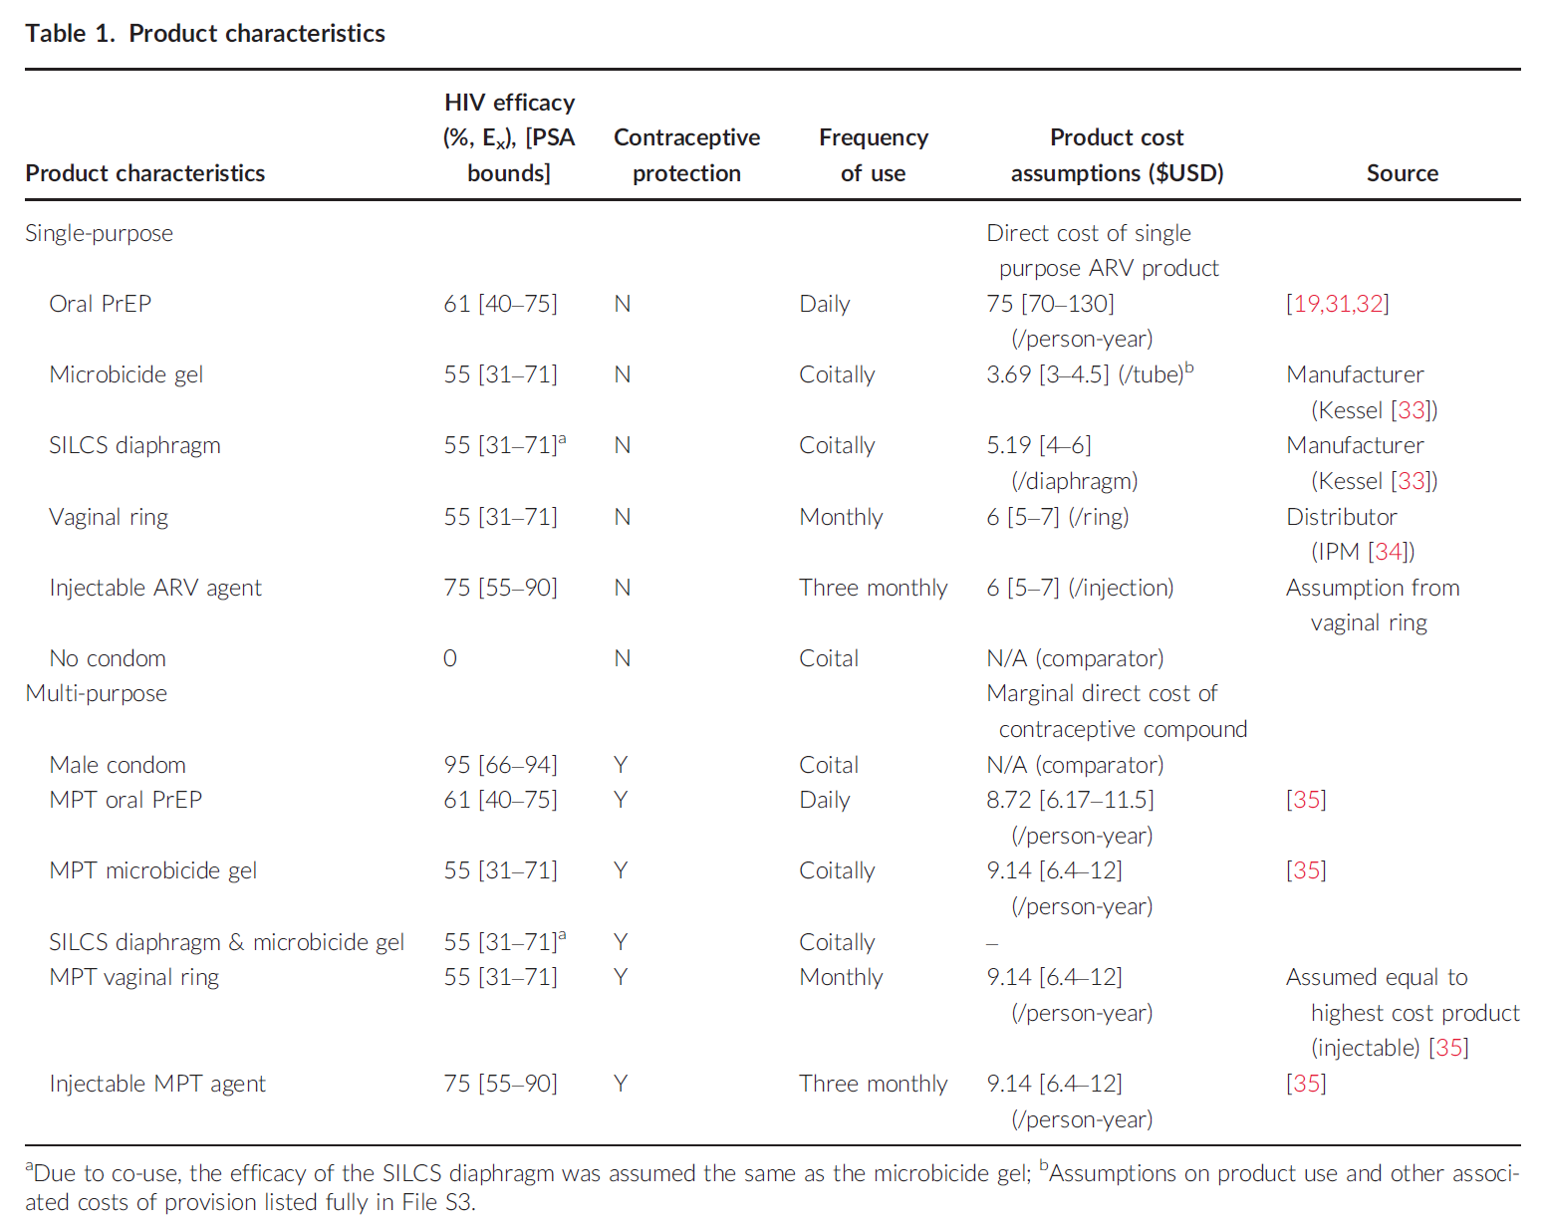

Slide 32
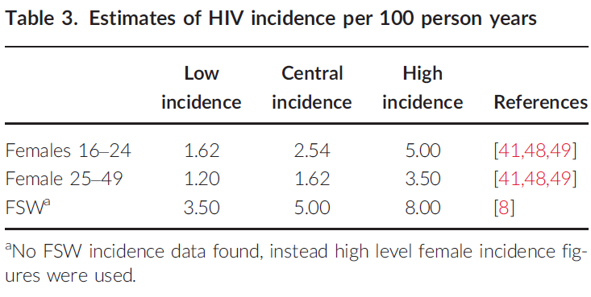
Incidence assumptions

Slide 33
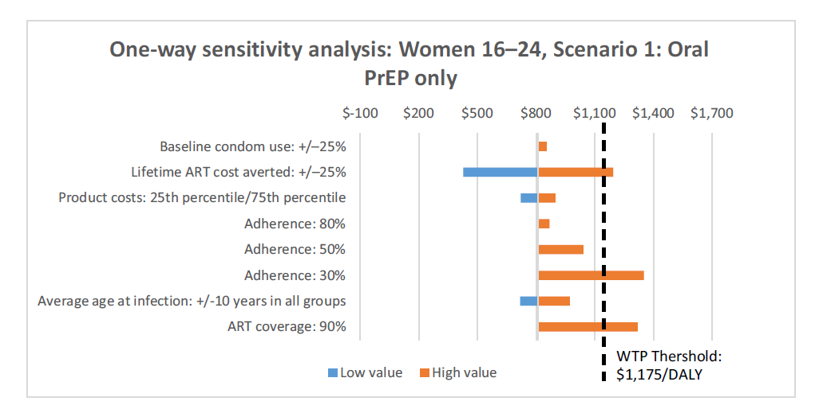

Slide 34
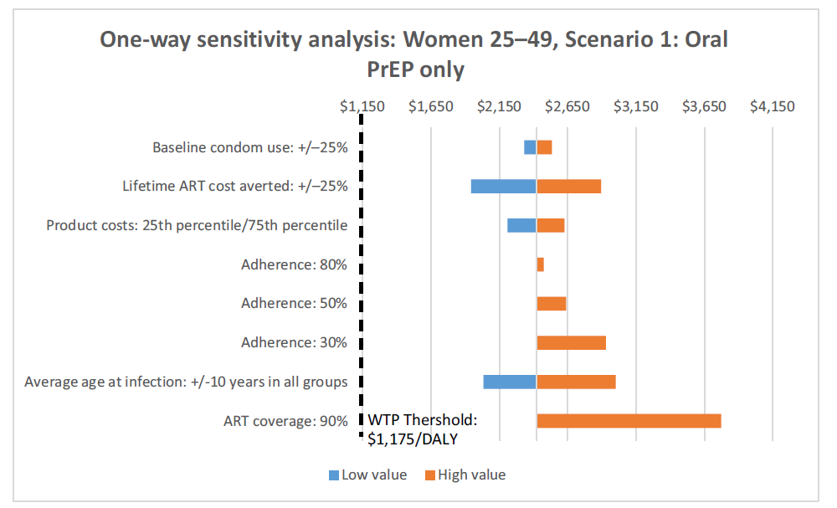

Slide 35
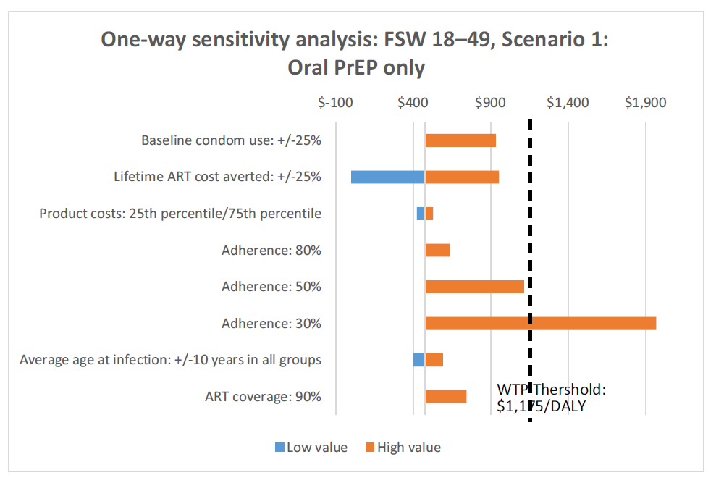

Slide 36
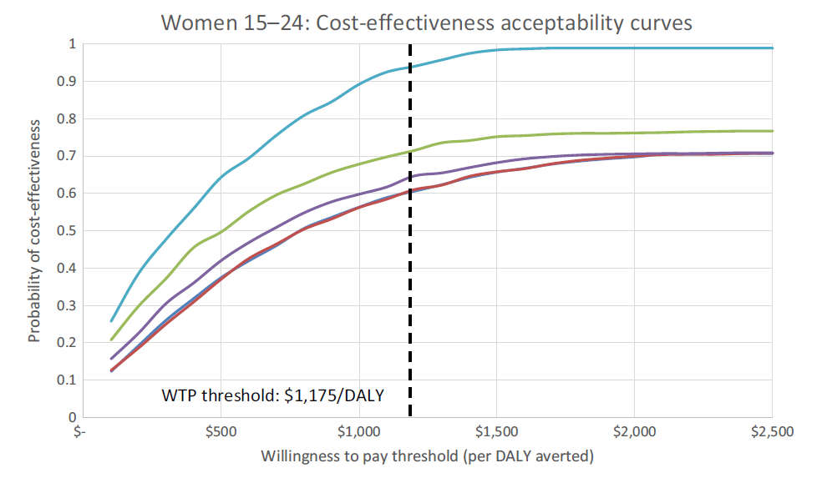
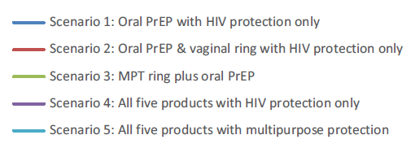

Slide 37
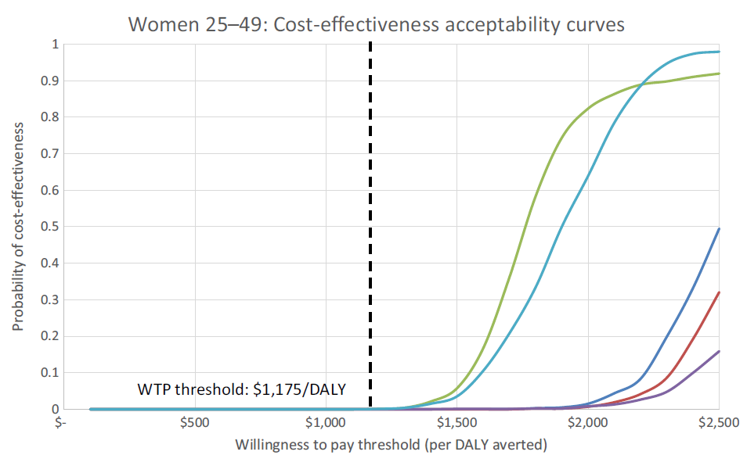

Slide 38
